Slide 1
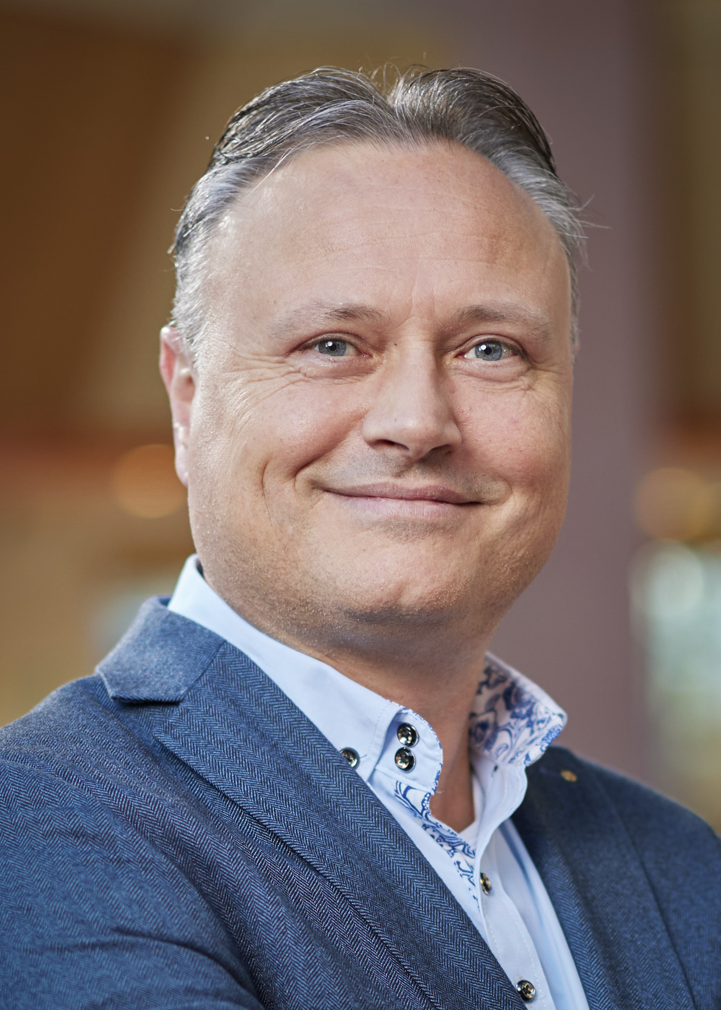
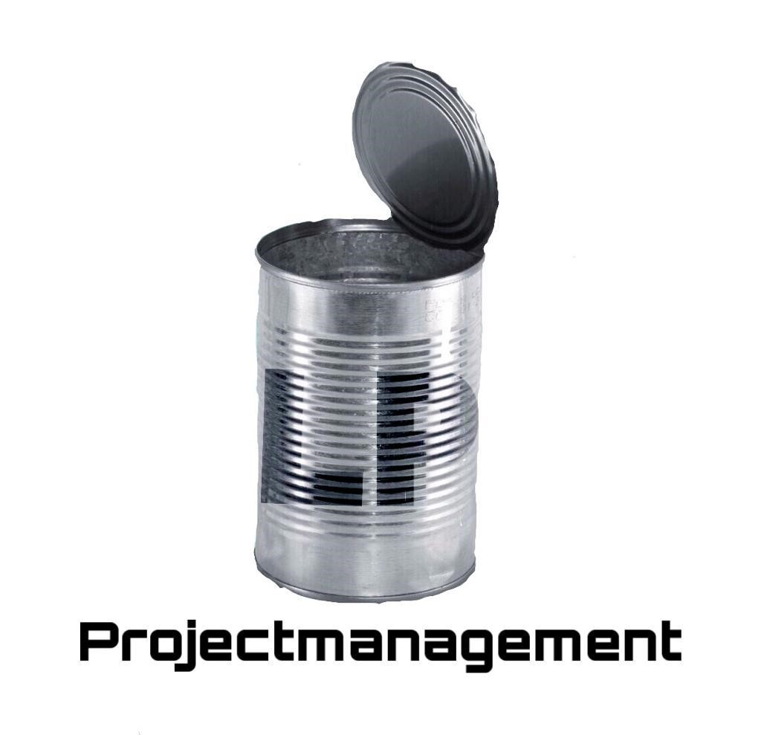





Curriculum Vitae
Talenkennis
Nederlands moedertaal
Engels goed
Duits goed
Opleiding
HTS: Elektrotechniek te Groningen
MTS: Elektrotechniek/Besturingstechniek te Groningen
Softskills
Helikopterview
Teamspeler
Visie / Strategie
Gestructureerd
Stakeholdermanagement
Verbinder
Mailadres
luuk.pastoor@lp-projectmanagement.com

Slide 2









Curriculum Vitae
Cursussen/certificering
Liberating Structures Immersion workshop (Agile)
HAZOP training
Workshop Agile werken
Werken in Bouwteams UAV – RCB
Basiscursus BRZO
Basiscursus RCB
Basiscursus ATEX
Basiscursus ARIBA
Agile training
Basistraining UAV-gc
VCA-VOL
BVL (Bewust Veilig Leidinggeven)
IPMA level B Projectmanagement
Incident analyses Topset methode
IPMA level C Projectmanagement
International Gas Value Chain course
Werkervaring
EET (LP-PM&C B.V.) Senior Project Manager – Terminal EET Eemshaven
Gasunie (LP-PM&C B.V.) Programmamanager (Taskforce Manager emissiereductie)
TenneT (LP-PM&C B.V. Sr. Project Manager Bay Replacement Programm (vervanging HS-stations)
Nijhuis Water Technologies (LP-PM&C) Sr. Project Construction Manager waterzuiveringsinstallatie BP Lingen (D)
Van Merksteijn Green Steelmill (LP-PM&C)) Sr. Project Manager
Venko (a Brand Safway company) Sr. Project Manager / Contract Manager
Engie (Equans) Sr. Project Manager (consortium aQuaintance)
Stork Technical Services BV Noordoost Sr. Project Manager (consortium GLT-Plus)
Eekels Elektrotechniek (TBI Groep) Sr. Project Manager
Stork Industry Services E&I Noordoost Project Manager (consortium SRT)
KPN Project Engineer

